Slide 1
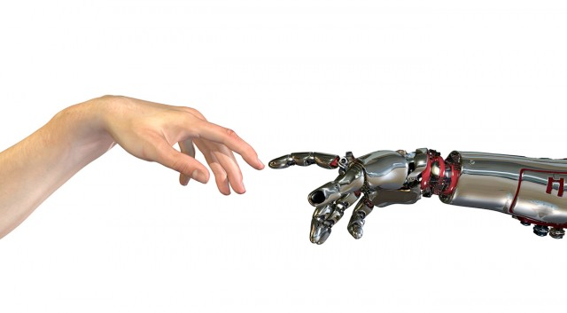
Machine Learning
6. andere modellen en ensemble learning

Slide 2
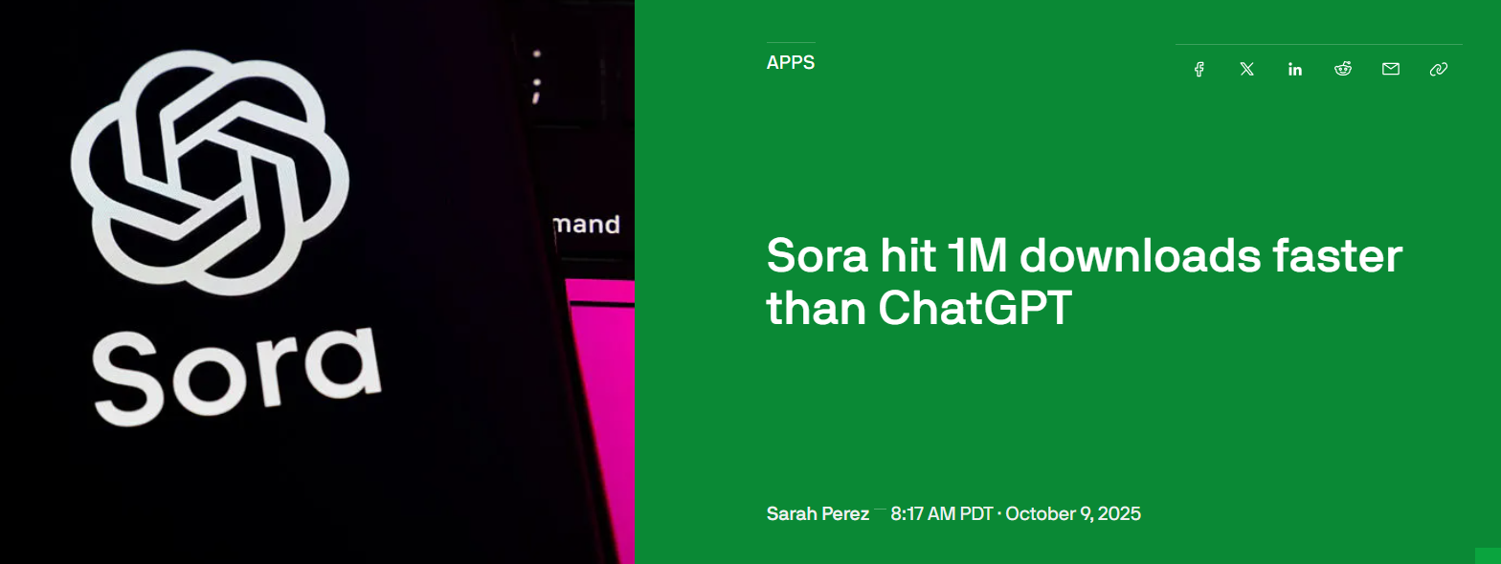
ML Actueel
https://openai.com/nl-NL/index/sora-2/

Slide 3
Classificatie van classificatie-algoritmen
Linear classifiers
Fisher's linear discriminant
Logistic regression
Naive Bayes classifier
Perceptron
Support vector machines
Least squares support vector machines
Quadratic classifiers
Kernel estimation
k-nearest neighbor
Boosting (meta-algorithm)
Decision trees
Random forests
Neural networks
Learning vector quantization
Unsupervised clustering
k-means
DBSCAN

Slide 4
Onderwerp 1: andere (classificatie)modellen
Naive Bayes
Support Vector Classifiers/Machines
Clustering
k-means
DBSCAN
Decision trees

Slide 5
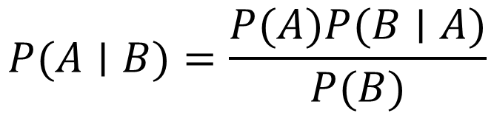
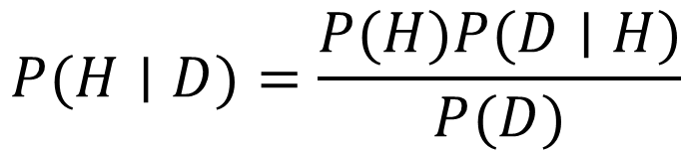
Bayes
$$P(A∣B)=\frac{P(A)P(B∣A)}{P(B)}$$
Prior
(Estimation)
Posterior
(P to compute)
Likelihood
(counted)
$$P(H∣D)=\frac{P(H)P(D∣H)}{P(D)}$$
Normalising constant
Notes:
The Bayes theorem calculates the conditional probability of A given B. We can use this simple theorem to calculate the probability of a hypothesis given some data (1) . This is called diachronic interpretation. For instance calculate the probability of a person getting Corona given the characteristics of a person (2). For this calculation we need the likelihood of the data based on prior knowledge(3). Likelihood we can count. For example the likelihood that a YOUNG person gets Corona. It is the probability of the data under the hypothesis which is the probability of D given H. p(H) (4) is the probability of the hypothesis before we see the data, called the prior. The prior sometimes can be calculated based on historical data, but sometimes is based on subjective estimation. The normalising constant is (5) the probability of seeing the data, it is a bit abstract concept, but with an example it will become more clear.
We can use this principle to calculate any class instance given the values of the features of that instance. It has a naive assumption that the features are independent from each other.

Slide 6
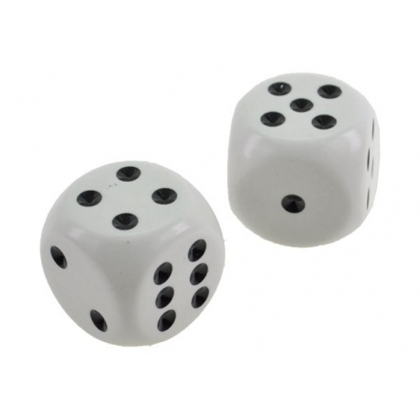
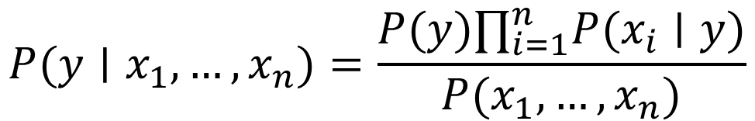
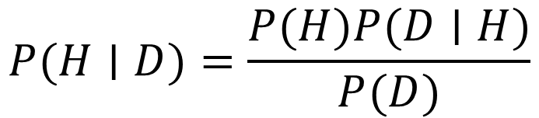
Naive Bayes
Aanname: alle features zijn even belangrijk en zijn onafhankelijk van elkaar
$$P(H∣D)=\frac{P(H)P(D∣H)}{P(D)}$$
$$P(y∣x_{1},…,x_{n})=\frac{P(y)∏_{i=1}^{n}P(x_{i}∣y)}{P(x_{1},…,x_{n})}$$
Notes:
Naive Bayes is an algorithm that is based on the bayes Theorem and popular in machine learning. Naive Bayes calculates the conditional probability of a class instance given the values of the features of that instance. It has a naive assumption that the features are independent from each other. Hence the name Naive Bayes. An example could be that in the example if we would like to compute the probability of a person having Corona based on age categorie and weight categorie then y = Corona Yes class, x1 is age category and x2 is weight category. The probability of a young light weighted person having corona is the product of the probality of corona times the probability of a young person having corona times the probability of a lightweighted person having corona divided by the probability of a ligthweighed person under the hypothesis. Let us work out the example with some numbers

Slide 7
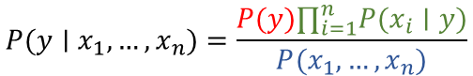
Voorbeeld: kans dat iemand lenzen nodig heeft (y) gegeven een aantal eigenschappen (x1 t/m x4)
AGE |  |  | SPECTACLE PRESCRIPTION |  |  | ASTIGMATISM |  |  | TEAR PROD RATE |  |  | LENSES RECOMMENDED
 | YES | NO |  | YES | NO |  | YES | NO |  | YES | NO | YES | NO
YOUNG | 2 | 3 | MYOPE | 2 | 2 | WAAR | 3 | 4 | REDUCED | 6 | 2 | 9 | 5
PREPRESBYOPIC | 4 | 0 | HYPERMETROPE | 4 | 2 | ONWAAR | 6 | 1 | NORMAL | 3 | 3
PRESBYOPIC | 3 | 2 | NORMAL | 3 | 1
YOUNG | 2/9 | 3/5 | MYOPE | 2/9 | 2/5 | WAAR | 3/9 | 4/5 | REDUCED | 6/9 | 2/5
PREPRESBYOPIC | 4/9 | 0/5 | HYPERMETROPE | 4/9 | 2/5 | ONWAAR | 0/9 | 1/5 | NORMAL | 3/9 | 3/5
PRESBYOPIC | 3/9 | 2/5 | NORMAL | 3/9 | 1/5
AGE | SPECTACLE PRESCRIPTION | ASTIGMATISM | TEAR PROD RATE
YOUNG | NORMAL | WAAR | NORMAL
2/9 | 3/9 | 3/9 | 3/9
$$p\left(Yes\right)=9/14×2/9×3/9×3/9×3/9=0,0053$$
$$P(y∣x_{1},…,x_{n})=\frac{P(y)∏_{i=1}^{n}P(x_{i}∣y)}{P(x_{1},…,x_{n})}$$
$$p\left(No\right)=5/14×3/5×1/5×4/5×3/5=0,0206$$
$$p(Yes)=0.0053/(0.0053+0.0206)=0.205$$
$$p(No)=0.0206/(0.0053+0.0206)=0.795$$
Notes:
Here is an example of the principle. This is an overview of the lens database. We want to predict whether a client needs lenses. The first three rows of the table display the data, the final three rows of the table display the relative numbers. Out of 9 Yes, they needed lenses, there were 2 YOUNG persons. Out of the 9 persons that needed a lens, there were 3 persons with a normal tear production rate. You clearly can see from the table that the features are independent from each other. They relation is only to the class (need lenses yes or no). So what if we have a new patient (1) of young age, normal spectacle prescription, with astigmatism and normal tear production rate. What is the probability that this person needs lenses? We can do the math based on the equation and then we find that for the probability that this person needs lenses it is the product of the independent feature probability under the hypothesis of yes (2) . We also need to calculate the probability of the No (3) chance since we need this for the normalisation factor of the probability of the data. So finally (4) we find that the probability of the new client needs lenses is 21 percent based on the value of the features age, spectacle prescription, astigmatism and tear production rate.

Slide 8
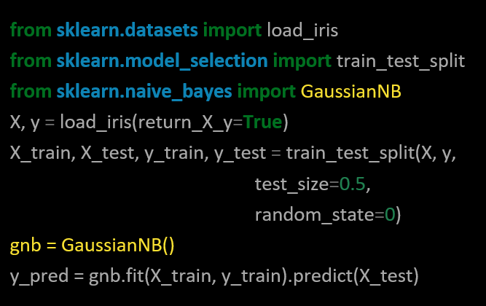
Naive Bayes in Code
https://scikit-learn.org/stable/modules/naive_bayes.html
NB: Gaussian wordt gebruikt als de features (ongeveer) normaal verdeeld zijn
Notes:
Skikit has a library for Naive Bayes. GaussianNB. Skitkit has a number of Naive Bayes libraries. CategoricalNB implements the categorical naive Bayes algorithm for categorically distributed data. MultinomialNB implements the naive Bayes algorithm for multi-nomially distributed data and ComplementNB implements the complement naive Bayes (CNB) algorithm. Naive Bayes is suitable for multi class problems as well. It can distinguish
Between more than two classes. It can handle multiple classes directly where linear classifiers or support vector machine are strictly binary and need another strategy to handle the multiple class problem.
So far we looked at supervised learning strategies for regression and classification. We looked at the logistic regression, support vector machines, decision trees and naive bayes. It is now time to compare the models and optimise our models. Next lecture we will discuss optimisation techniques like bagging, boosting and ensemble learning.

Slide 9
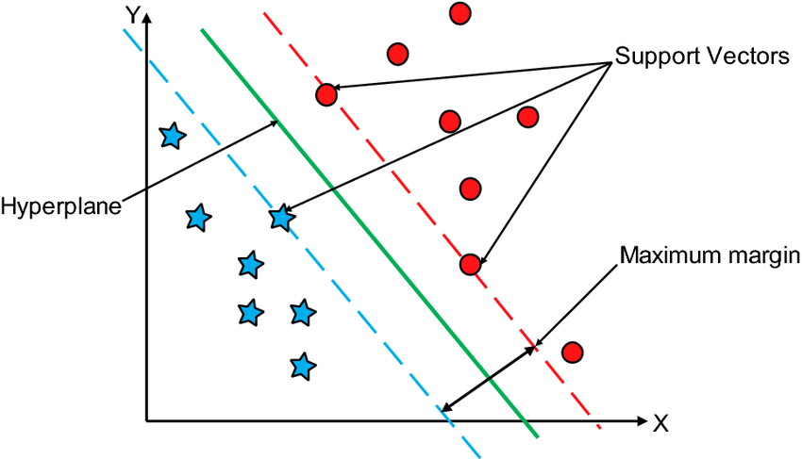
Support Vector Classifiers (SVC)
Doel: vinden van een optimale decision boundary tussen waarnemingen van verschillende klassen
Lijn (2D)
Vlak (3D)
Hyperplane (nD)
Kunnen goed omgaan met outliers (uitbijters)
Bron: researchgate.net

Slide 10
svm:Large Margin Classifier
Notes:
The fundament of the support vector machine is the maximum margin principle which is explained in the following minutes.

Slide 11
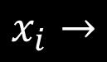
Observations class A
Observations class B
$$x_{i}→$$
Notes:
There are two classes class A and B and they look like they can easily be distinguished. The classification is done based on feature x

Slide 12
threshold
$$x_{i}→$$
Notes:
Lets make a treshold at value x where the blue dots stop. Consider new data points (yellow dots). These two are obviously class A and B

Slide 13
threshold
$$x_{i}→$$
Notes:
But consider this point, whit the green treshold it will be classified as B but it looks like it belongs to A

Slide 14
threshold
Max Margin Classifier
margin
Notes:
If we take the maximal distance (margin) between the two classes and we put our threshold here it might perform better. This is called max margin classifier.

Slide 15
threshold
Notes:
Now it will be correctly classified

Slide 16
threshold
Notes:
The distance to A is smaller then the distance to class B, So this is accurate.

Slide 17
svm:Soft Margin Classifier

Slide 18
threshold
Outlier
margin
Notes:
But what if we have an outlier and we use the same principle to set the treshold. Then our threshold we be put close to B

Slide 19
threshold
Notes:
And then again the datapoint can be again wrongly classified.

Slide 20
threshold
Misclassification
soft margin
Notes:
If we ignore the outlier, and accept that this is a misclassification the principle of margins does work.

Slide 21
Soft Margin Classifier = Support Vector Classifier (SVC)
threshold
Misclassification
soft margin
Notes:
In the case that we ignore the misclassifications (the outliers) we use soft margins instead of hard margins. We search for the maximum cohesion of observations to determine the outliers and thence the soft margins.

Slide 22
Soft Margin Classifier = Support Vector Classifier (SVC)
threshold
Misclassification
support vectors
soft margin
Notes:
We need outliers as well as the soft margins to determine the thresholds. These we call support vectors.

Slide 23
threshold
Misclassification
Notes:
Now we see that with this soft margin principle the datapoint is correctly classified

Slide 24
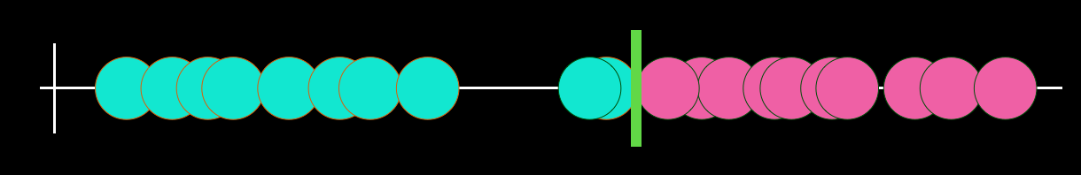
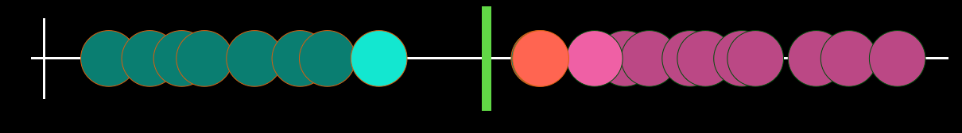
Variance
Bias
overfitting < --- > underfitting
Notes:
The higher the variance the more prone to overfitting. The higher the bias more prone to underfitting. Remember there is a balance between those.

Slide 25
svm:Kernels

Slide 26
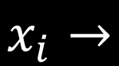
$$x_{i}→$$
Notes:
Sometimes you cannot use linear distance (one line) to determine the margins and thresholds, since the magenta points are left and right from the cyan points.

Slide 27
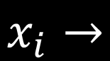
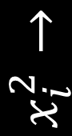
$$x_{i}^{2}→$$
threshold
$$x_{i}→$$
Notes:
You should use a trick like adding an order in the equation to distinguish the two classes

Slide 28
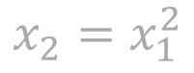
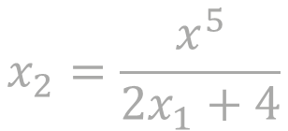
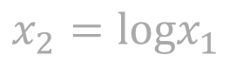
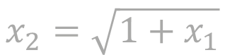
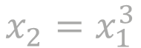
Plan
1. Start with low dimensionality
2. Introduce higher dimensionality for same data
3. Train SVC to differentiate
$$x_{2}=x_{1}^{2}$$
$$x_{2}=logx_{1}$$
How do we know to introduce higher dimensionality?
$$x_{2}=x_{1}^{3}$$
$$x_{2}=\frac{x^{5}}{2x_{1}+4}$$
$$x_{2}=\sqrt{1+x_{1}}$$
Notes:
The question however is, what equation to use? We call such a equation a kernel

Slide 29
sklearn.svm.SVC()
kernel: string, optional (default=’rbf’)
Specifies the kernel type to be used in the algorithm. It must be one of ‘linear’, ‘poly’, ‘rbf’, ‘sigmoid’, ‘precomputed’ or a callable. If none is given, ‘rbf’ will be used. If a callable is given it is used to pre-compute the kernel matrix from data matrices; that matrix should be an array of shape (n_samples, n_samples).
degree: int, optional (default=3)
Degree of the polynomial kernel function (‘poly’). Ignored by all other kernels.
gamma{‘scale’, ‘auto’} or float, default=’scale’
Kernel coefficient for ‘rbf’, ‘poly’ and ‘sigmoid’.
if gamma='scale' (default) is passed then it uses 1 / (n_features * X.var()) as value of gamma,
if ‘auto’, uses 1 / n_features
if float, must be non-negative.
https://scikit-learn.org/stable/modules/generated/sklearn.svm.SVC.html
Notes:
So using the svm algorithm we need to specify the kernel. You can also implement your own kernel.

Slide 30
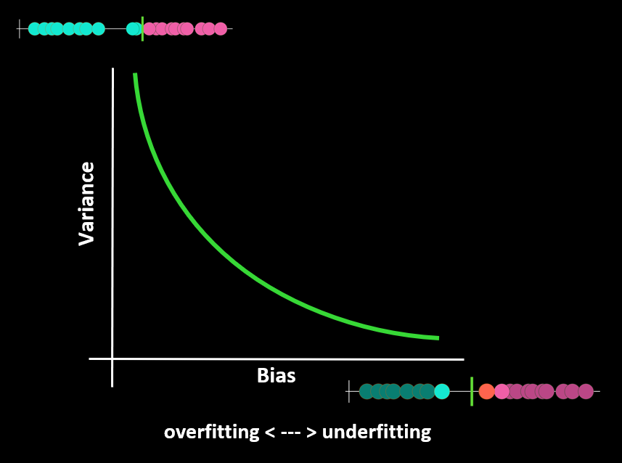
sklearn.svm.SVC()
C: float, optional (default=1.0)
Regularization parameter. The strength of the regularization is inversely proportional to C. Must be strictly positive. The penalty is a squared l2 penalty.
Hoe lager C, hoe zachter de marges => meer bias, richting underfitting
Hoe hoger C, hoe harder de marges => minder bias, richting overfitting
https://scikit-learn.org/stable/modules/generated/sklearn.svm.SVC.html
Notes:
C is the regularisation parameter.

Slide 31
Voorbeelden

Slide 32
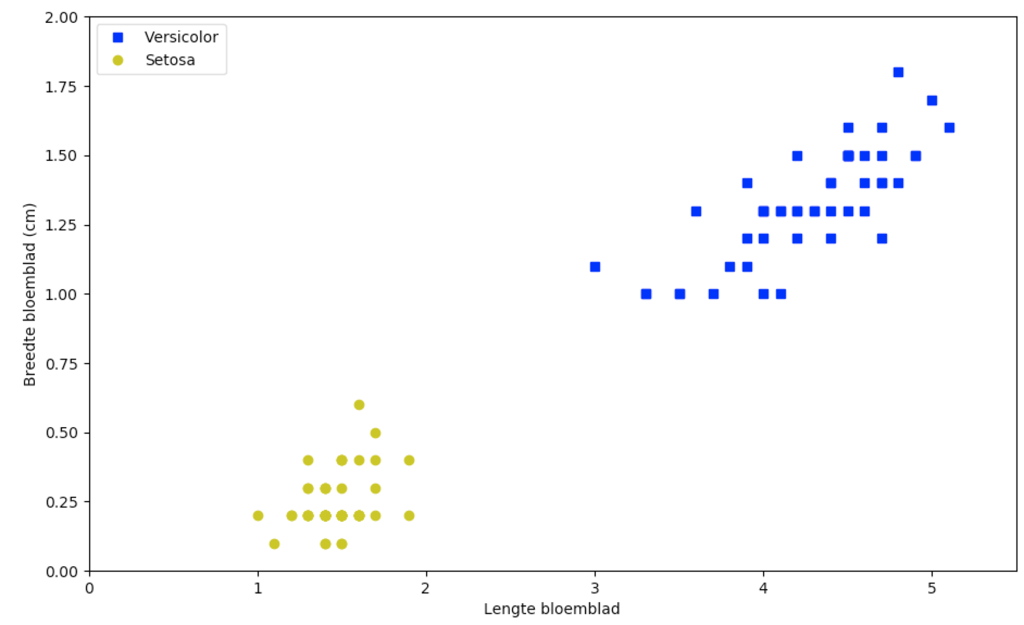
Notes:
Suppose we have two classes of the iris flower, versicolor and setosa. We can determine on the features petal length and petal width the decision boundery

Slide 33
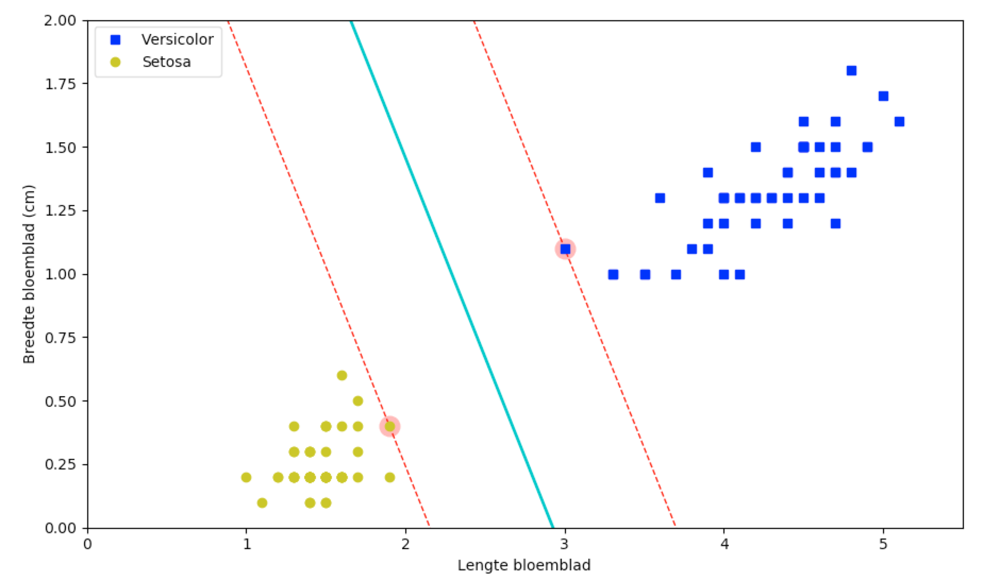
svm_clf = SVC(kernel="linear", C=float("inf"))
svm_clf.fit(X, y)
Notes:
As you can see, there is a reasonable distance between the *boundary* and the two support vectors (the ones with the glow). Also note that adding more examples on either side of the boundary does not make the classification better or more accurate: the lines in the figure above are completely determined by the boundary cases on either side of the “street”, the support vectors.

Slide 34
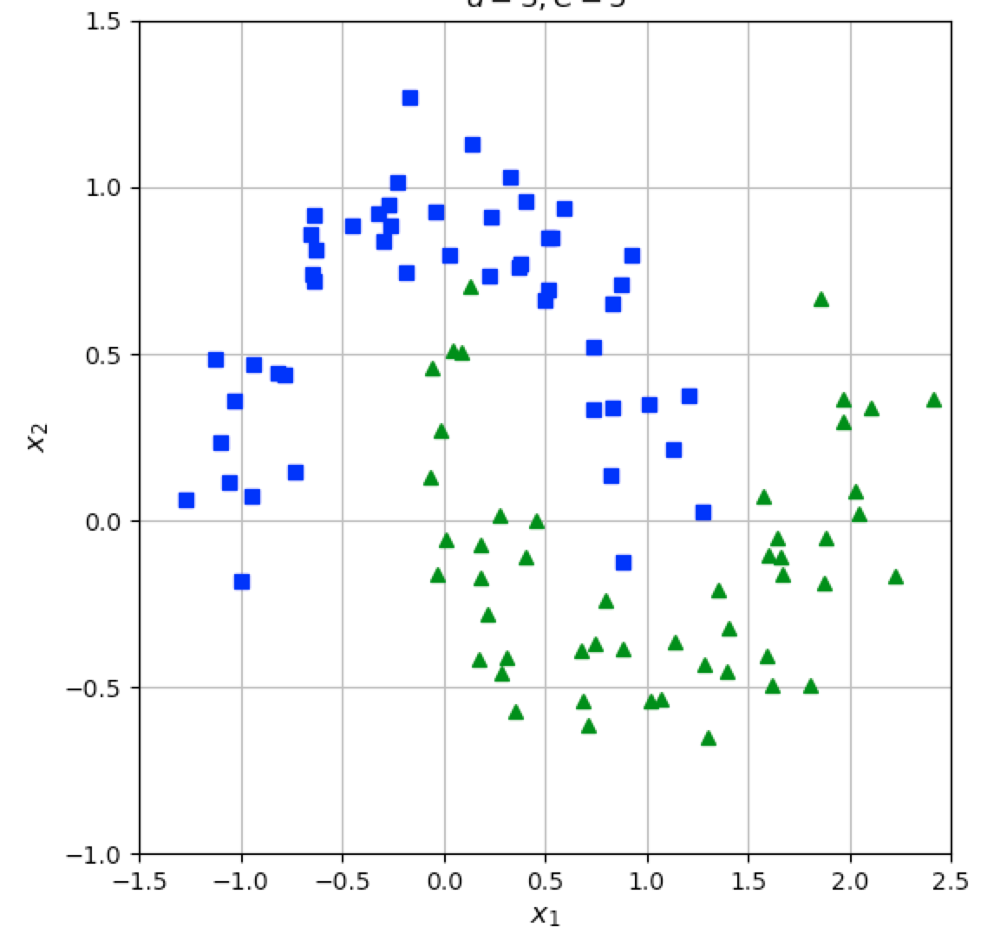
Notes:
These two classes clearly need some kind of polynomial kernel to separate the two classes. A straight line won’t fit.

Slide 35
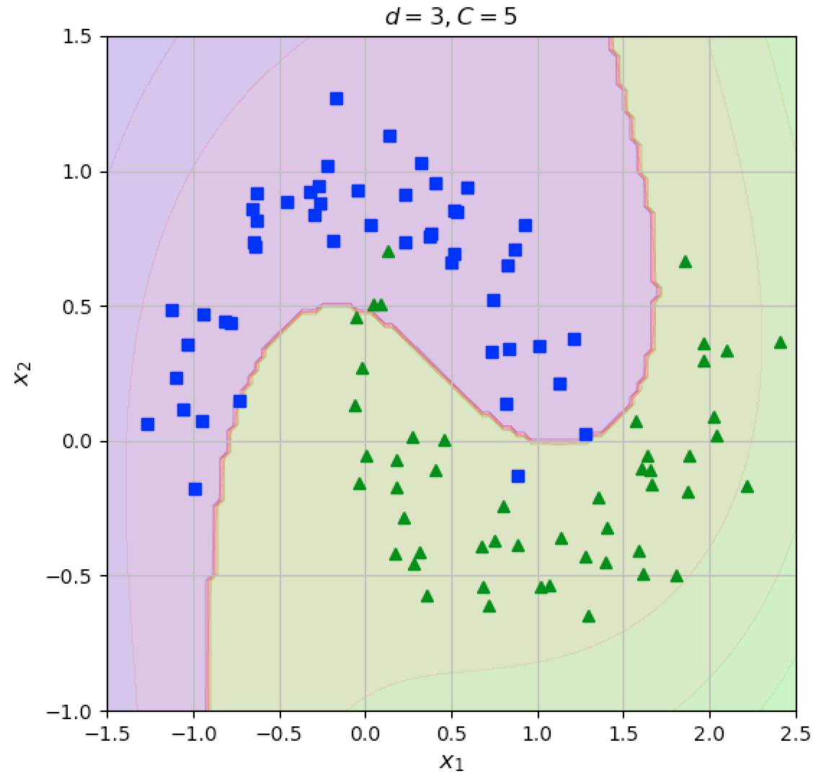
Notes:
We could use a third degree polynomial with a regularisation factor of 5

Slide 36
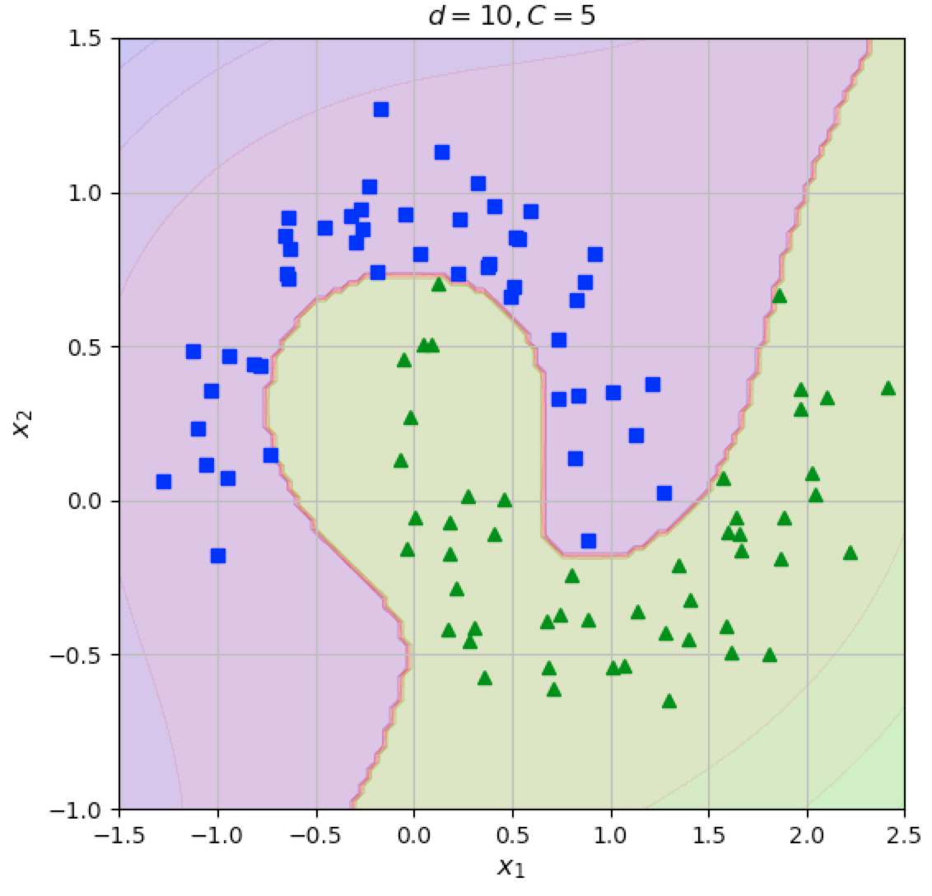
Notes:
Or a tenth degree polynomial with a regularisation factor of 5

Slide 37
Clustering: algemeen
Gelijksoortige observaties samen groeperen
Zonder te classificeren
Voorbeeld van unsupervised learning

Slide 38
Clustering: k-means
Kies het gewenste aantal clusters
Geef elk cluster een random centroid (middelpunt)
Daarna afwisseling van twee stappen:
Assignmentstap: wijs elke observatie toe aan het cluster met de dichtstbijzijnde centroid
Updatestap: herbereken de centroids op basis van de aan elk cluster toegewezen observaties

Slide 39
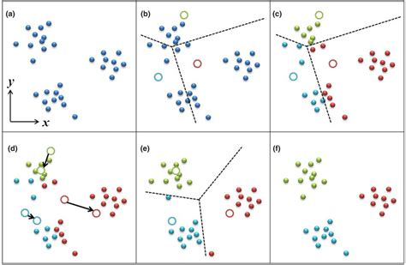
Clustering: k-means
Bron: researchgate.net

Slide 40
Clustering: k-means
Initialisatie van de centroids:
Random (niet zo handig)
Op basis van voorkennis
Kiezen uit meerdere random initialisaties
Metric: inertia (sum of squared distances to centroids)
k-means++
Bevorder dat de initiële centroids ver uit elkaar liggen

Slide 41
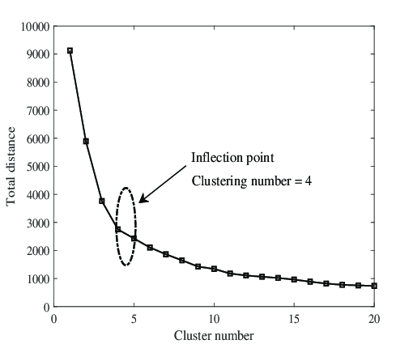
Clustering: k-means
Keuze van het aantal clusters:
“Elbow method”
Inertia
Bron: researchgate.net

Slide 42
Clustering: DBSCAN
Density-Based Spatial Clustering of Applications with Noise
Twee parameters:
ε (eps)
minPts

Slide 43
Clustering: DBSCAN
Het algoritme werkt als volgt:
Zoek de observaties in de straal ε van elk punt. Identificeer als core points de observaties met meer dan minPts buren.
Zoek de connected components van de core points, oftewel de core points die binnen straal ε van elkaar liggen. Deze vormen samen een cluster.
Wijs elk niet-core point toe aan een naburig cluster als dat cluster binnen straal ε ligt, zo niet dan is het ruis / een uitbijter (outlier).

Slide 44
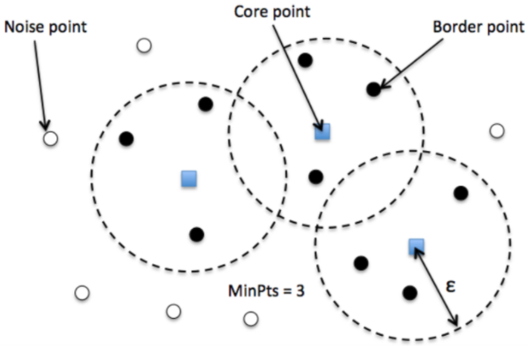
Clustering: DBSCAN
Bron: miro.medium.com

Slide 45
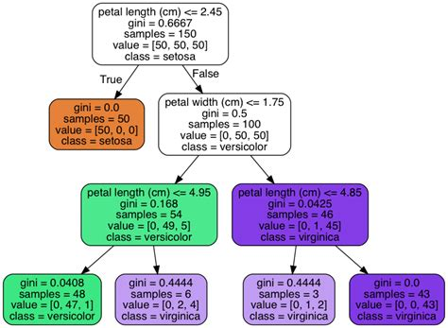
Decision trees

Slide 46
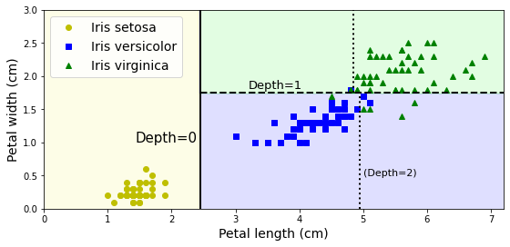
Decision trees: decision boundaries
Bron: https://github.com/ageron/handson-ml3/blob/main/06_decision_trees.ipynb

Slide 47
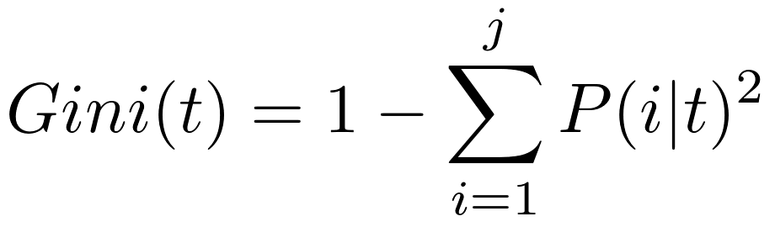
Decision trees: gini-impurity

Slide 48
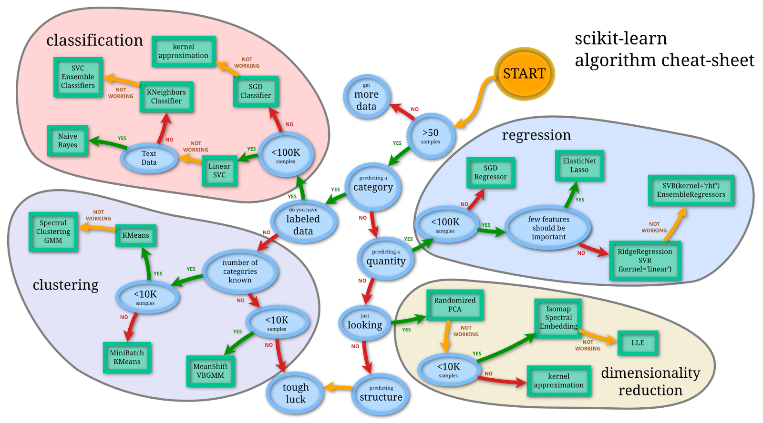

Slide 49
Live Notebooks
Decision trees
k-means
DBSCAN

Slide 50
Ensemble Learning

Slide 51
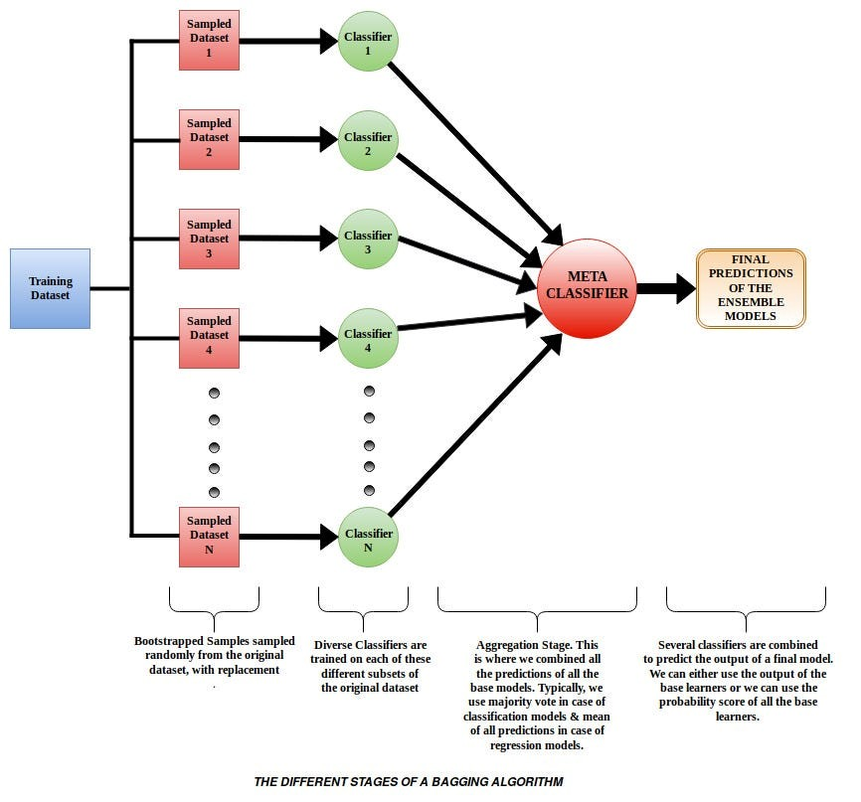

Slide 52
Voting, bagging en pasting (1)
Voting: verschillende soorten classifiers
Onafhankelijk en ongecorreleerd (voorzover mogelijk)
Elk met een eigen uitkomst
Hard voting: de vaakst voorspelde uitkomst wint
Soft voting: de uitkomst met de gemiddeld hoogste waarschijnlijkheid wint

Slide 53
Voting, bagging en pasting (2)
Bagging = Bootstrap Aggregating
Bagging en Pasting: meerdere keren dezelfde classifier
Elk getraind op een andere subset van de data
Met teruglegging: Bagging
Zonder teruglegging: Pasting
Output: meest voorkomende classificatie (hard voting)

Slide 54
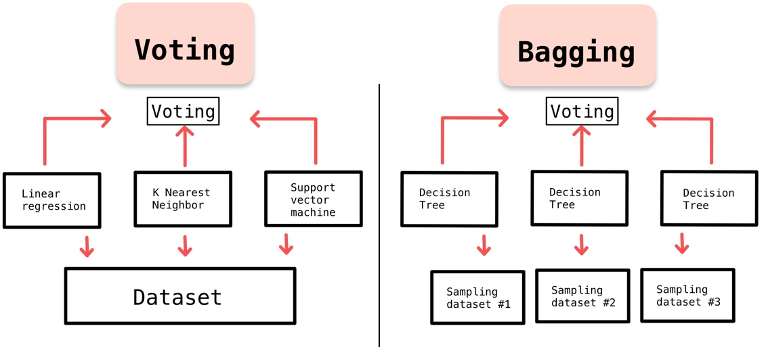
Voting, bagging en pasting (3)
Bron: medium.com

Slide 55
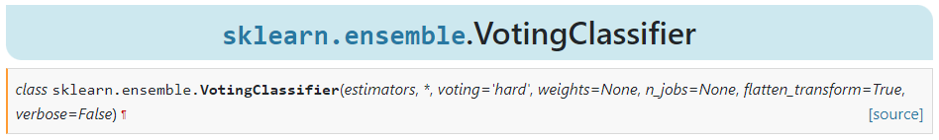
Voting in sklearn
Lijst van tuples: (naam, classifier)
Bijvoorbeeld:
('lr', LogisticRegression(random_state=42))
hard of soft

Slide 56
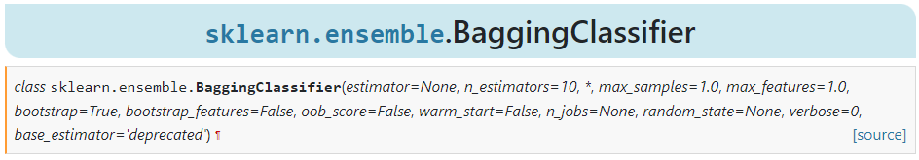
Bagging in sklearn
False => pasting
Bijvoorbeeld:
from sklearn.ensemble import BaggingClassifier
from sklearn.tree import DecisionTreeClassifier
bag_clf = BaggingClassifier(DecisionTreeClassifier(), n_estimators=500, max_samples=100, n_jobs=-1, random_state=42)
bag_clf.fit(X_train, y_train)

Slide 57

Intermezzo
Live Notebook over Voting classifiers

Slide 58
Reminder: Decision Trees
Bij elke node kiezen we de feature die het meeste onderscheid kan maken

Slide 59
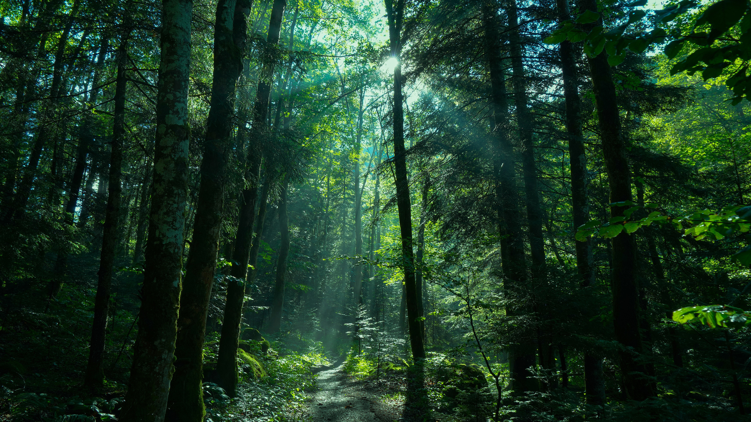
Random Forest
Ensemble van Decision Trees
Gebruikt bagging als aggregator
Wat is er random aan?
Bij het splitsen op een node wordt er niet uit alle features gekozen…
…maar uit een random subset
By default worden er √n features van de n overwogen
Gevolg: meer diversiteit in de bomen
Minder variantie, meer bias
Voorkomt overfitting van het model als geheel

Slide 60
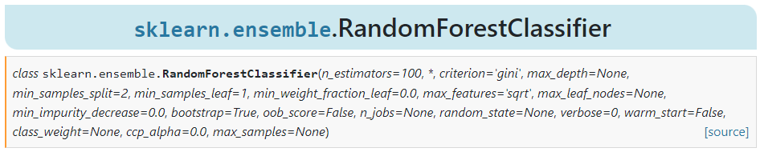
RandomForest in sklearn

Slide 61
Boosting (1)
Sequentieel trainen van classifiers
Nadeel: niet parallelliseerbaar
Algoritmes:
AdaBoost
Fout geclassificeerde instances door het vorige model krijgen hoger gewicht in (de beoordeling van) het volgende model
Gradient Boosting
Volgende model wordt getraind op de error (y-y_pred) van het vorige
Learning rate η

Slide 62
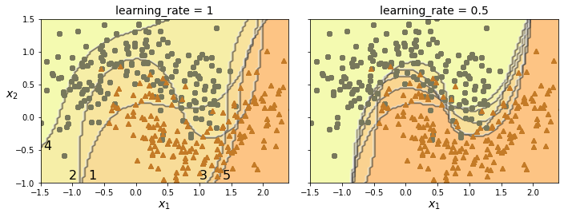
Boosting (2) - AdaBoost
AdaBoost met verschillende Learning Rates

Slide 63
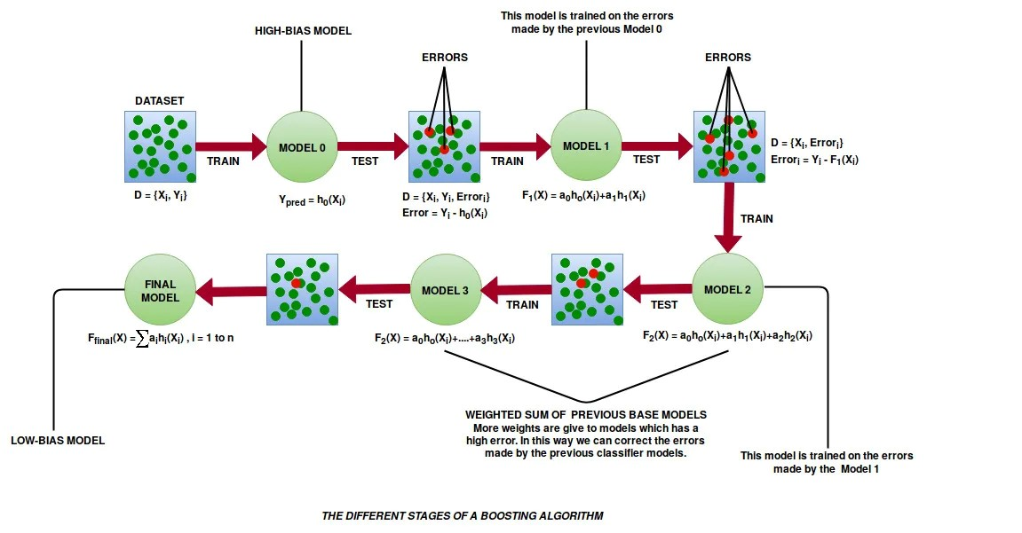
Boosting (3) – gradient boosting

Slide 64
Stacking (1)
Alternatief voor Voting en Bagging/Pasting
Gebruik geen simpel algoritme zoals Voting…
…maar gebruik weer een Machine Learning-model!
Dit model wordt gevoed door de onderliggende classifier-modellen
Blender of Meta learner

Slide 65
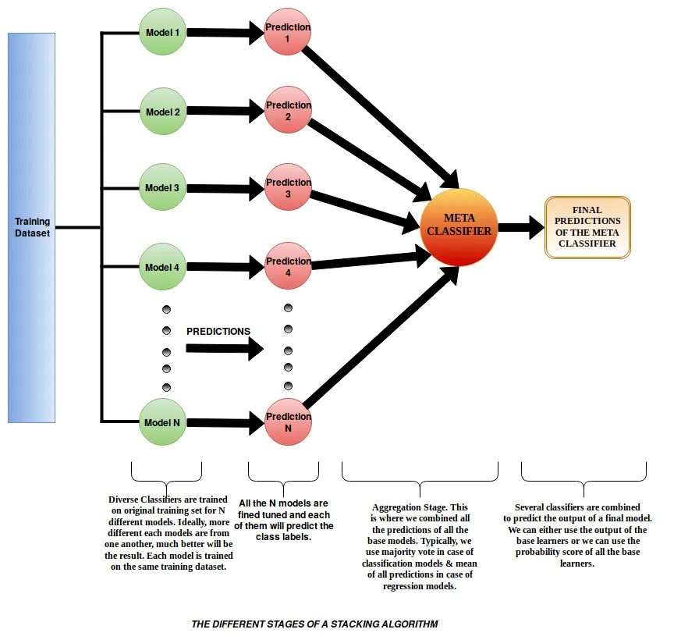
Stacking (2)

Slide 66
Afsluiting
Live Notebook over Random Forests

